Slide 1


ClassQuest
Turning Classrooms into RPG Adventures
Capstone Project – University of Regina
Team: Alvin Tolentino | Tolani Oke-Steve | Dmytro Stepaniuk
Professor: Tim Maciag

Slide 2





Meet the Quest Forging Team
Alvin Tolentino
Frontend Developer / UI-UX Designer
Crafting the visual magic and user experience.
Tolani Oke-Steve
Frontend Developer / UI-UX Designer
Focusing on accessible and engaging interface design.
Dmytro Stepaniuk
Project Manager / Backend Developer
Managing scope and building the secure architecture.
Professor Tim Maciag
Academic Supervisor
Guiding our academic rigor and project execution.
Teacher-Clients
Brian Nenson & Kelly Chambers
Our vital partners from Saskatchewan Public Schools.

Slide 3




The Missing Treasure: Why a New Tool is Needed
The Gap Left by Classcraft: After the discontinuation of a beloved, engaging classroom RPG tool, educators were left without a comprehensive alternative.
Fragmented Focus: Existing popular platforms, such as Khan Academy or ClassDojo, tend to focus either on static lesson delivery or basic behavior management.
Lack of Integration: Critically, none seamlessly combine high-level learning objectives, true RPG-style mechanics, and collaborative teamwork.

Slide 4




Our Opportunity: Forging a New Path
We are stepping in to fill this critical engagement gap with ClassQuest, a purpose-built solution designed specifically for educators in our community.
This is an opportunity to provide a superior, localized, and practical alternative for transforming classrooms.
Affordable & Flexible
Web-Based Simplicity
Chromebook Optimized
ClassQuest is designed to be fun for students while remaining simple and powerful for teachers.

Slide 5
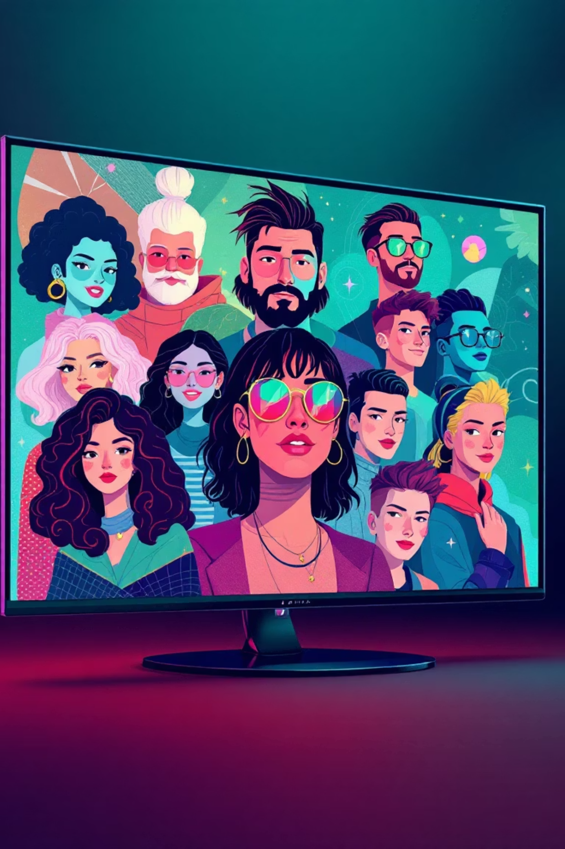




ClassQuest: The Mechanics of Fun
ClassQuest transforms the standard classroom experience into a personalized role-playing adventure, integrating core academics with game design elements.
Guilds & Avatars
Students join teams and customize their characters to begin their journey.
Progression & Rewards
Earn XP, Gold, and Hearts for homework, participation, and projects.
Teacher as GM
Teachers manage the world, assign quests, and control the flow of the narrative.
Boss Battles
High-stakes exams, major assignments, or quarterly tests become epic 'Boss Battles'.

Slide 6
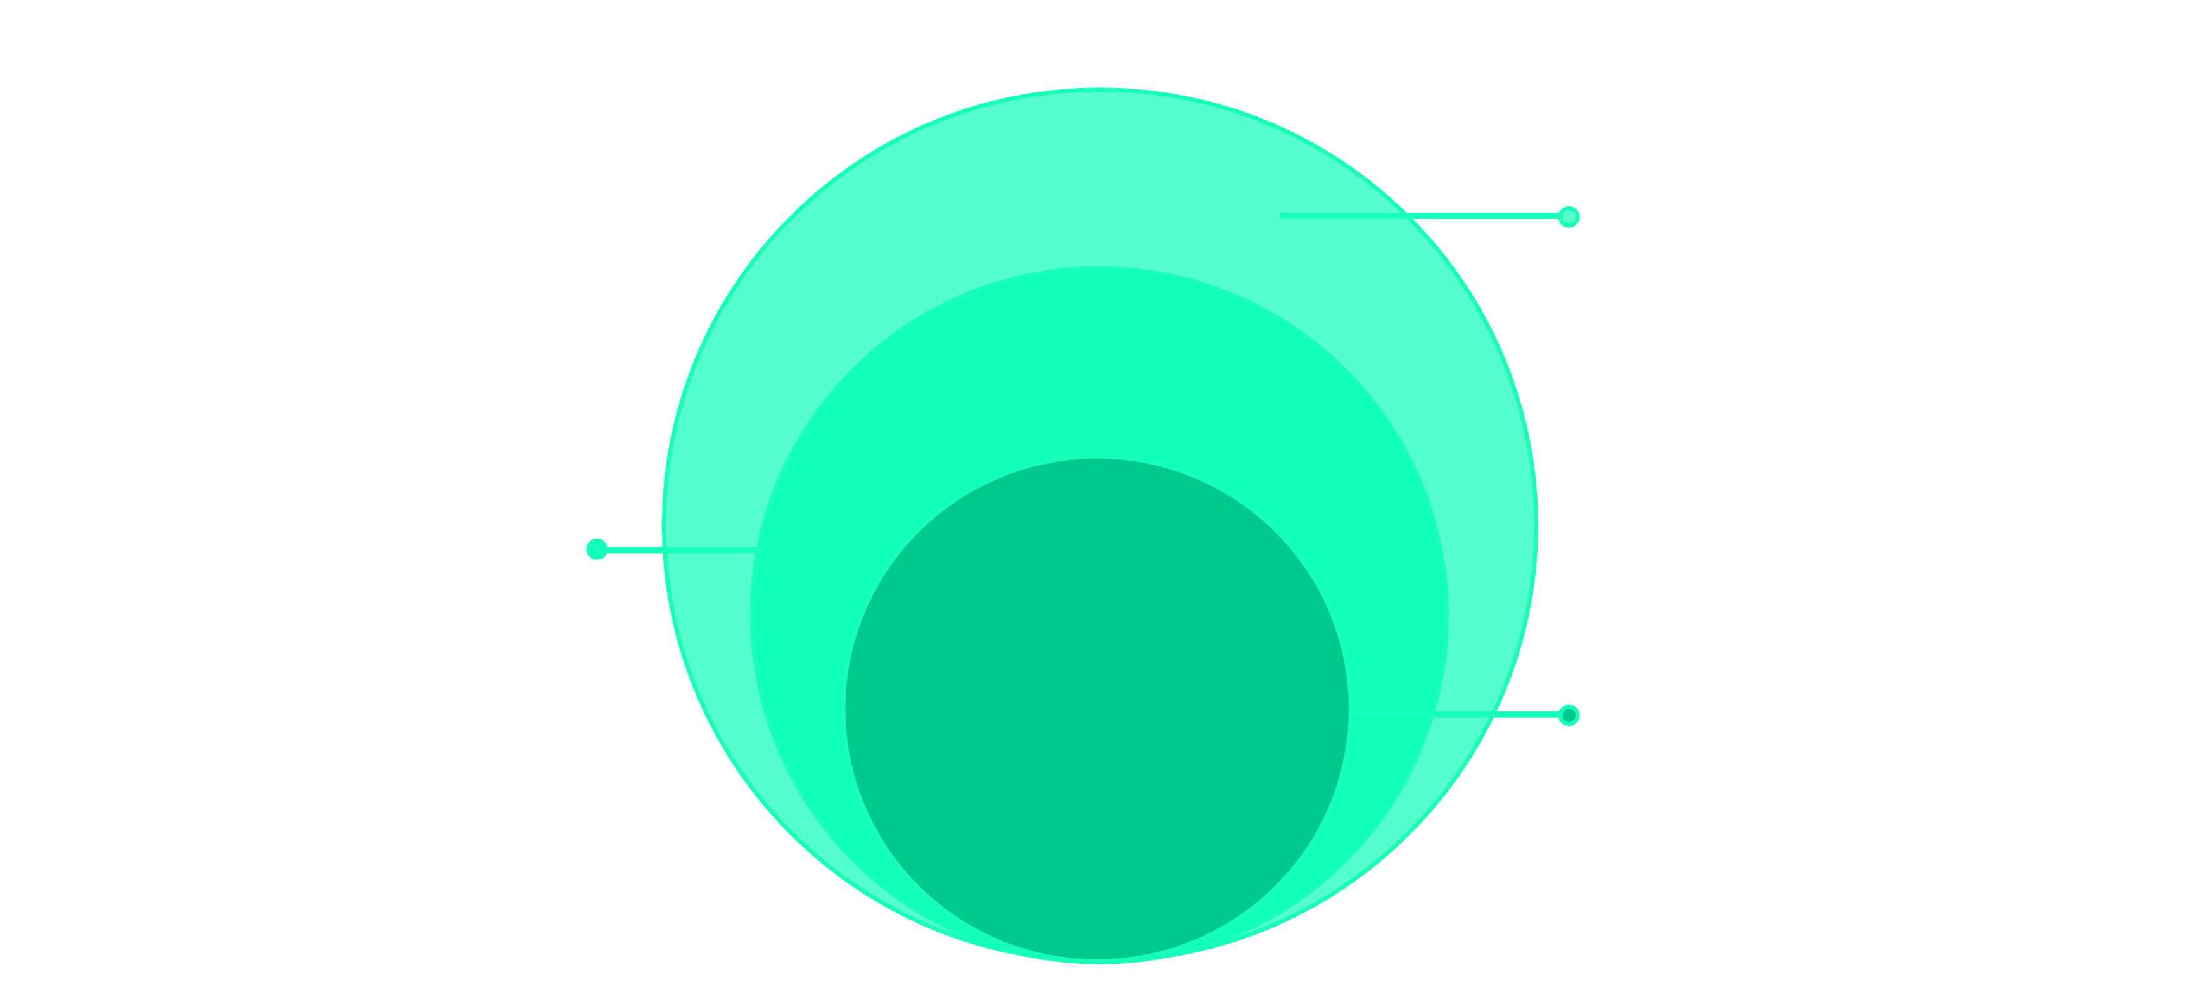
Our Why: The Golden Circle of ClassQuest
We define our purpose, process, and product to ensure every design choice aligns with our central mission: making learning irresistible.
What
Web-based RPG platform for classrooms
How
Gamify assignments into quests and achievements
Why
Make learning engaging and social again

Slide 7


Shifting the Paradigm: Impact & Value Proposition
Current Reality
New Reality (ClassQuest)
Students are often passively disengaged, and teachers are forced to juggle multiple, non-integrated behavioral and grading tools.
We create collaborative, immersive classrooms that consistently inspire internal motivation and a lasting love for learning.
To achieve this new reality, we prioritize three core build requirements:
Develop a simple, easy-to-access browser-based system.
Strongly reinforce teamwork and positive peer support.
Ensure robust data security and privacy compliance.

Slide 8

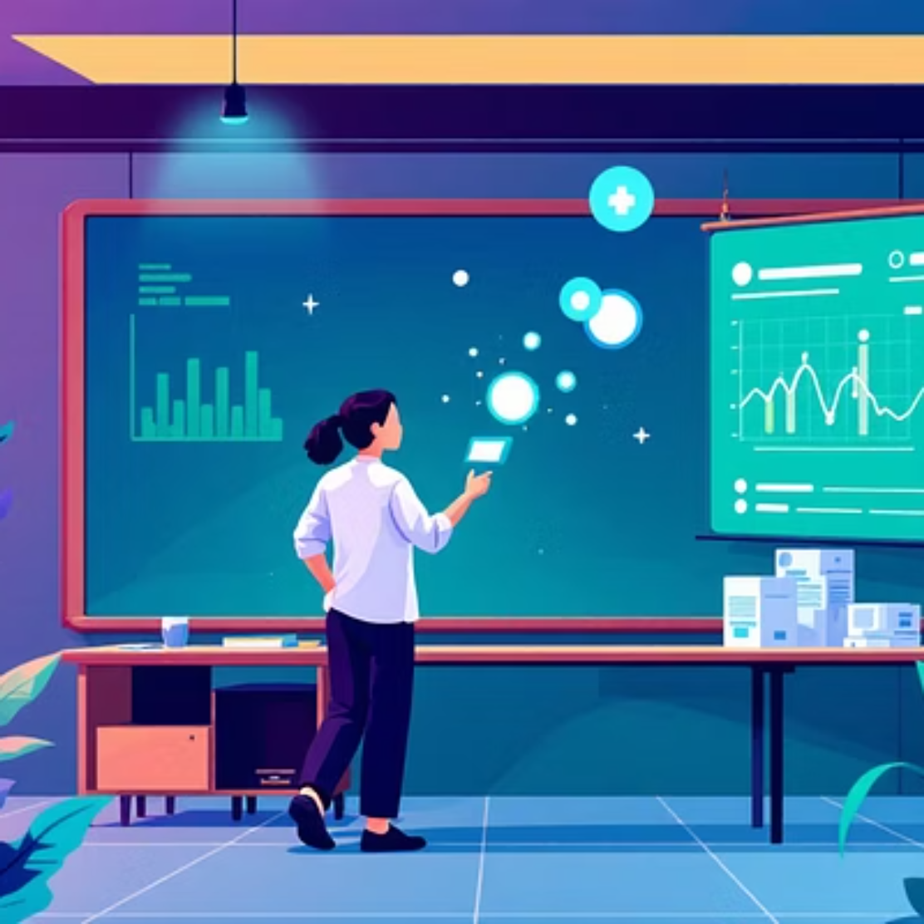





Who Are We Building for? Our Guild Members
The Students (Grades 5–8)
The Teachers
The Parents
Love games and instant gratification.
Need automation for repetitive tasks.
Seek high-level visibility into progress.
Typically have short attention spans.
Require templates for quick lesson setup.
Value transparency and results.
Rely primarily on Chromebooks for school work.
Tools must enhance student engagement.
Prefer insights over micromanagement tools.

Slide 9
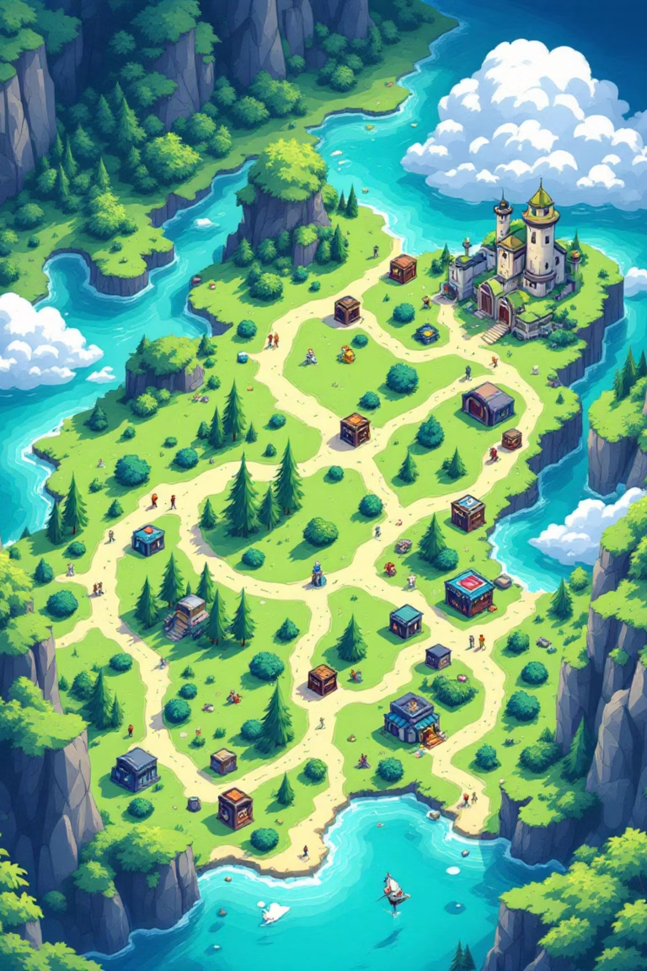








The Minimal Viable Product (MVP): Our First Artifact
Core Features of the ClassQuest MVP
The Campaign Constraints
Secure Access: Utilizing secure logins and unique classroom codes for enrollment.
Tight Timeline: Complete development in just 8 months.
Gamified Elements: Custom avatars, guilds, collaborative quests, and engaging "boss battles" for assessments.
Progress System: A motivating XP, Gold, and Hearts system for tracking effort and rewards.
Small Team: Efficient execution with only three core developers.
Teacher Tools: Intuitive dashboards, pre-built templates, and limited student leaderboards for competitive fun.
Compliance: Strict adherence to privacy and accessibility standards.
Platform: Must ensure seamless and fast functionality on standard Chromebooks.

Slide 10
The ClassQuest Development Timeline
Phase 1: Initiation & Planning
1
September
Requirements analysis, tool selection, and client sign-off.
2
Phase 2: System Design
October – November
Phase 3: Development (MVP)
3
Database schema, API architecture, and initial UI/UX mockups.
December – February
Core feature build-out and integration of fantasy mechanics.
4
Phase 4: Testing & Iteration
March
Phase 5: Delivery & Presentation
5
Internal QA, security audits, and deployment to test environments.
April
Final deployment, documentation, and capstone presentation.
Tech Stack: The Tools of the Trade
React | Tailwind (Frontend) | Node.js & Express (API) | MongoDB Atlas (Database) | Cloud Hosting

Slide 11




Business Aware Design (BAD) Principles
The Core Benefit
Our primary mission is to re-ignite student engagement and foster critical collaboration skills.
Our Approach
We employ iterative prototyping combined with continuous, weekly feedback sessions with teachers.
Key Deliverables
A fully functional MVP, comprehensive training materials, and permanent demo accounts for evaluation.

Slide 12
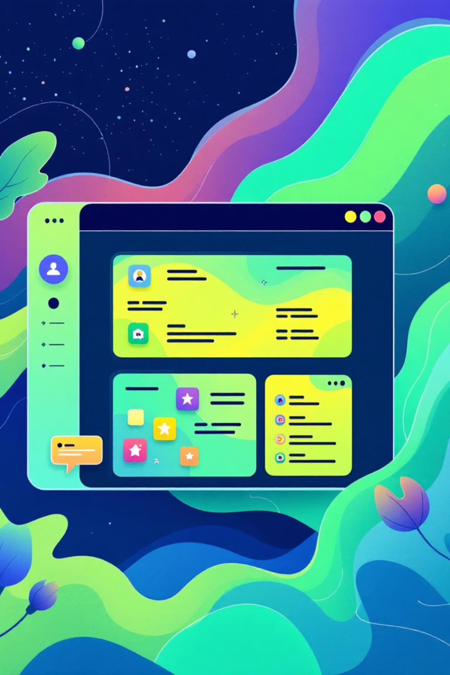
Project Management Body of Knowledge (PMBOK)
Stakeholder Communication
Ensuring continuous and transparent feedback loops, particularly with primary contacts Brian & Kelly.
Scope Management
Vigilantly managing the project scope to prevent the debilitating effects of "feature creep" on the timeline.
Risk Control
Proactively identifying, tracking, and mitigating potential risks using a structured backlog and sprint system.

Slide 13
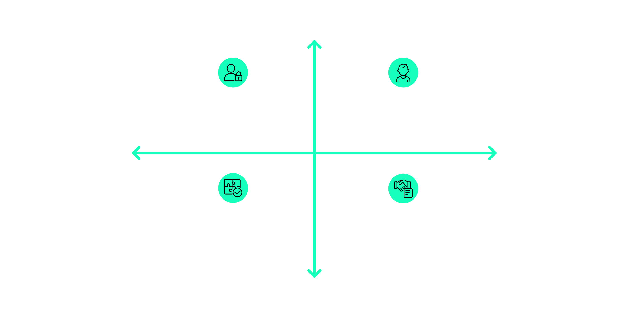




Our Stakeholders: The Council of Allies
Understanding the power and interest of our key partners is crucial for project success.
Primary Focus
High Interest
Teachers
Students (Our End Users)
We ensure maximum engagement and continuous feedback from this group.
Supportive Stakeholders: University of Regina, Professor Maciag
Primary Stakeholders: Teachers, Students
Key Supporters
Parents
Low Power
High Power
University of Regina / Prof. Maciag
Community Partners
This group provides essential oversight, resources, and credibility.
Secondary Support: Community Partners
Secondary Stakeholders: Parents
Low Interest

Slide 14
Risks & Mitigation Strategies
Risk: Overloading Backlog
Too many features added mid-sprint can lead to critical delays in the overall timeline.
Mitigation: Agile Sprints
Implementing short, focused Agile sprints with fixed goals prevents scope inflation.
Risk: Technical Challenges
Unforeseen integration or platform compatibility issues could slow down the MVP's readiness.
Mitigation: Frequent Testing
Dedicated weekly testing periods on production environments, especially Chromebooks.
Risk: Feature Creep
New requests distracting from the core MVP functionality leading to loss of focus.
Mitigation: Clear Scope Reviews
Strict weekly reviews of the project charter and prioritizing must-have features.

Slide 15

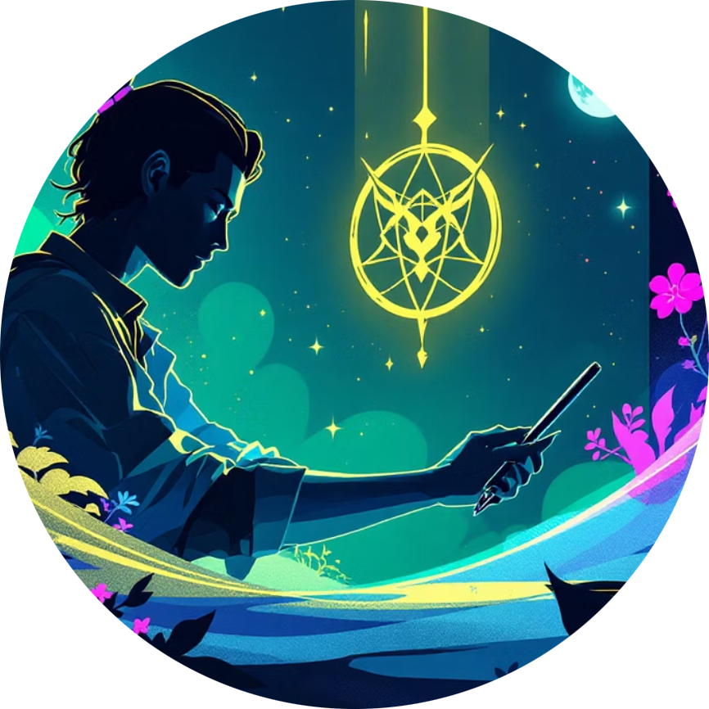

Thank You
Team ClassQuest
Alvin Tolentino
Tolani Oke-Steve
Dmytro Stepaniuk
Frontend Developer / UI-UX Designer
Frontend Developer / UI-UX Designer
Project Manager / Backend Developer
University of Regina – Capstone Project 2025–2026

